Slide 1
Co-ordination hypothesis
Leaves should optimise protein allocation/investment such that energy capture and carboxylation are co-limiting under average daytime conditions

Slide 2
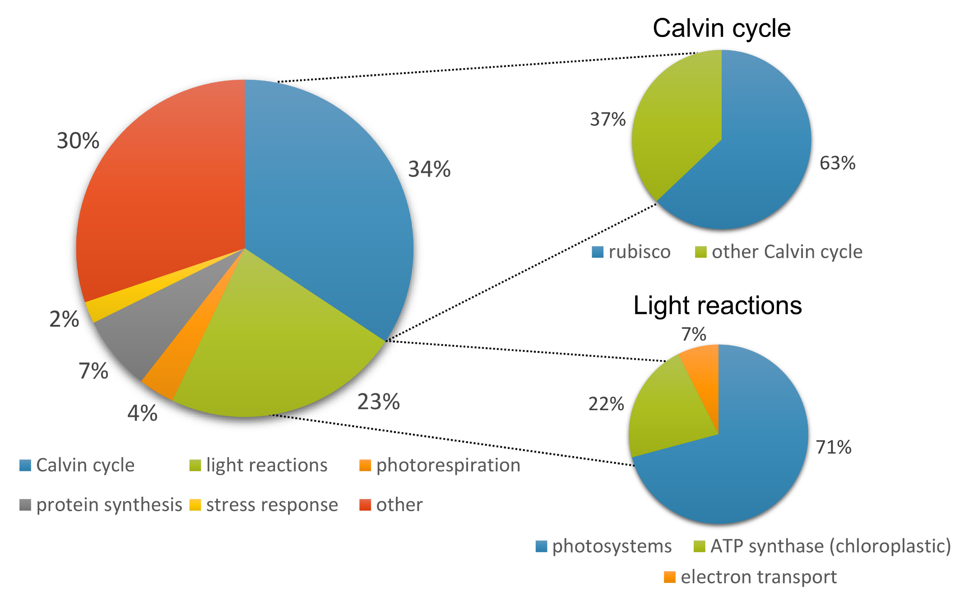
What’s in a leaf?
Total protein content ranges between 2 and 27% (mean 11%, SD 4%)
Notes:
Around 60% of the protein in our euc leaves was accounted for by photosynthesis proteins.
The mean abundances of the different functional categories shift around – as different samples have different proportions of protein within a given functional category at a given rank.
There are some gaps in the data here because of the cumulative summing code I used – it finds the average proportion of total protein for a given rank, and if there aren’t any proteins from that rank for a particular functional category then there’s a gap. Or just a point if there was just one sample with a protein at that rank.
The categories that have super abundant proteins – that would be Rubisco in the Calvin cycle and ATP synthase – start off being the most abundant but are gradually replaced as we increase the number of proteins.

Slide 3
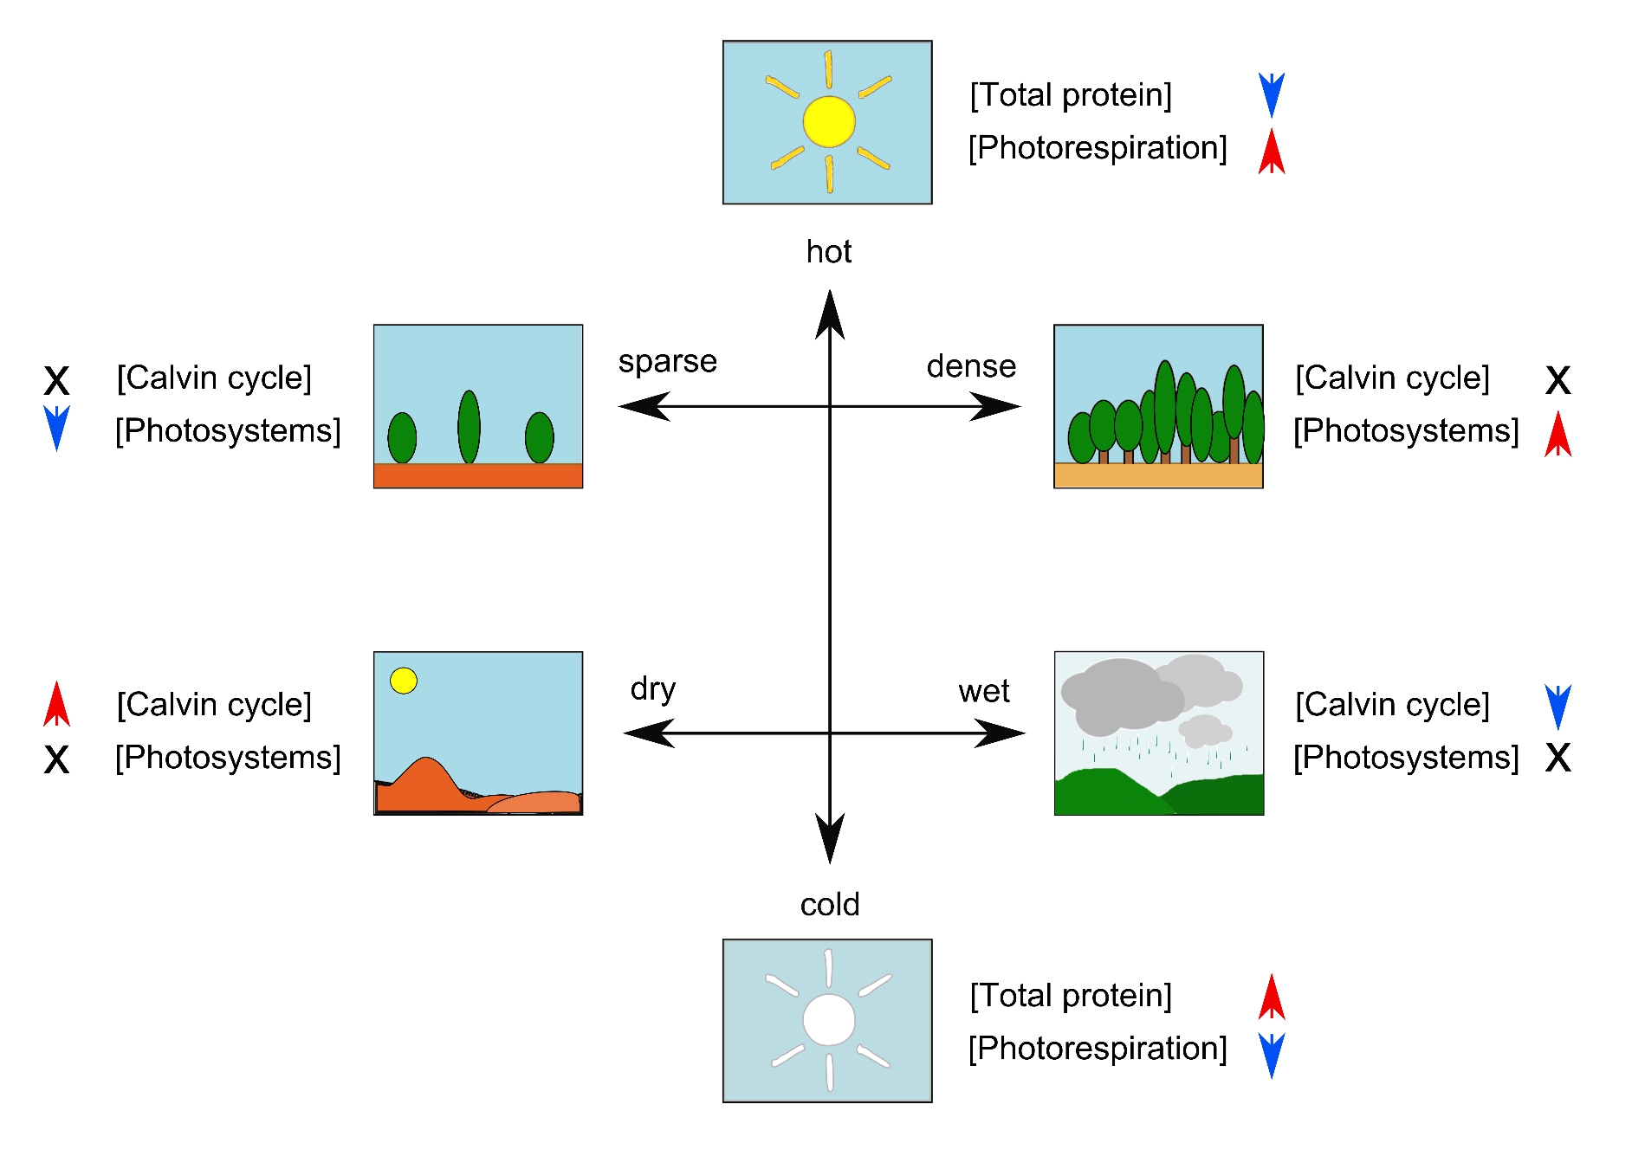
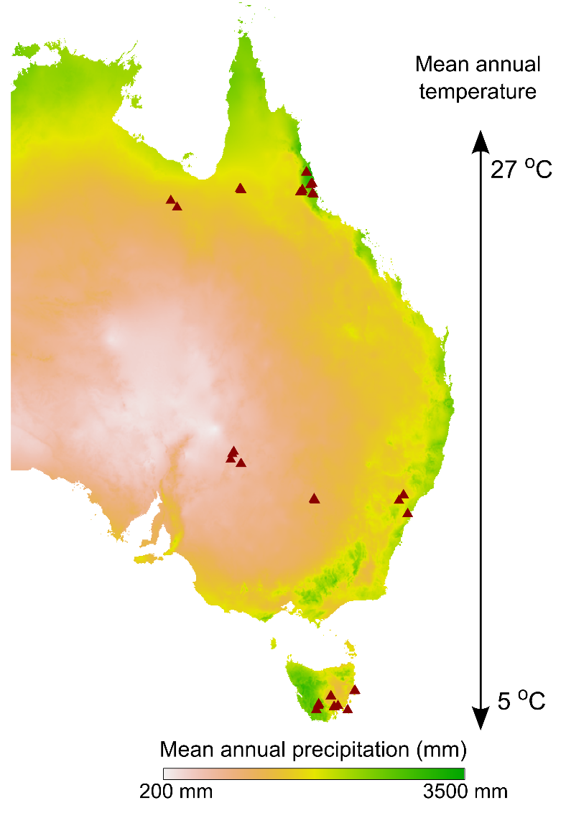
Environmental trends in leaf protein abundance

Slide 4
Total protein content is greater at lower temperatures
p < 0.001, R² = 0.49
p = 0.18

Slide 5


Total protein content is greater at lower temperatures
p < 0.001, R² = 0.49
p = 0.18

Slide 6
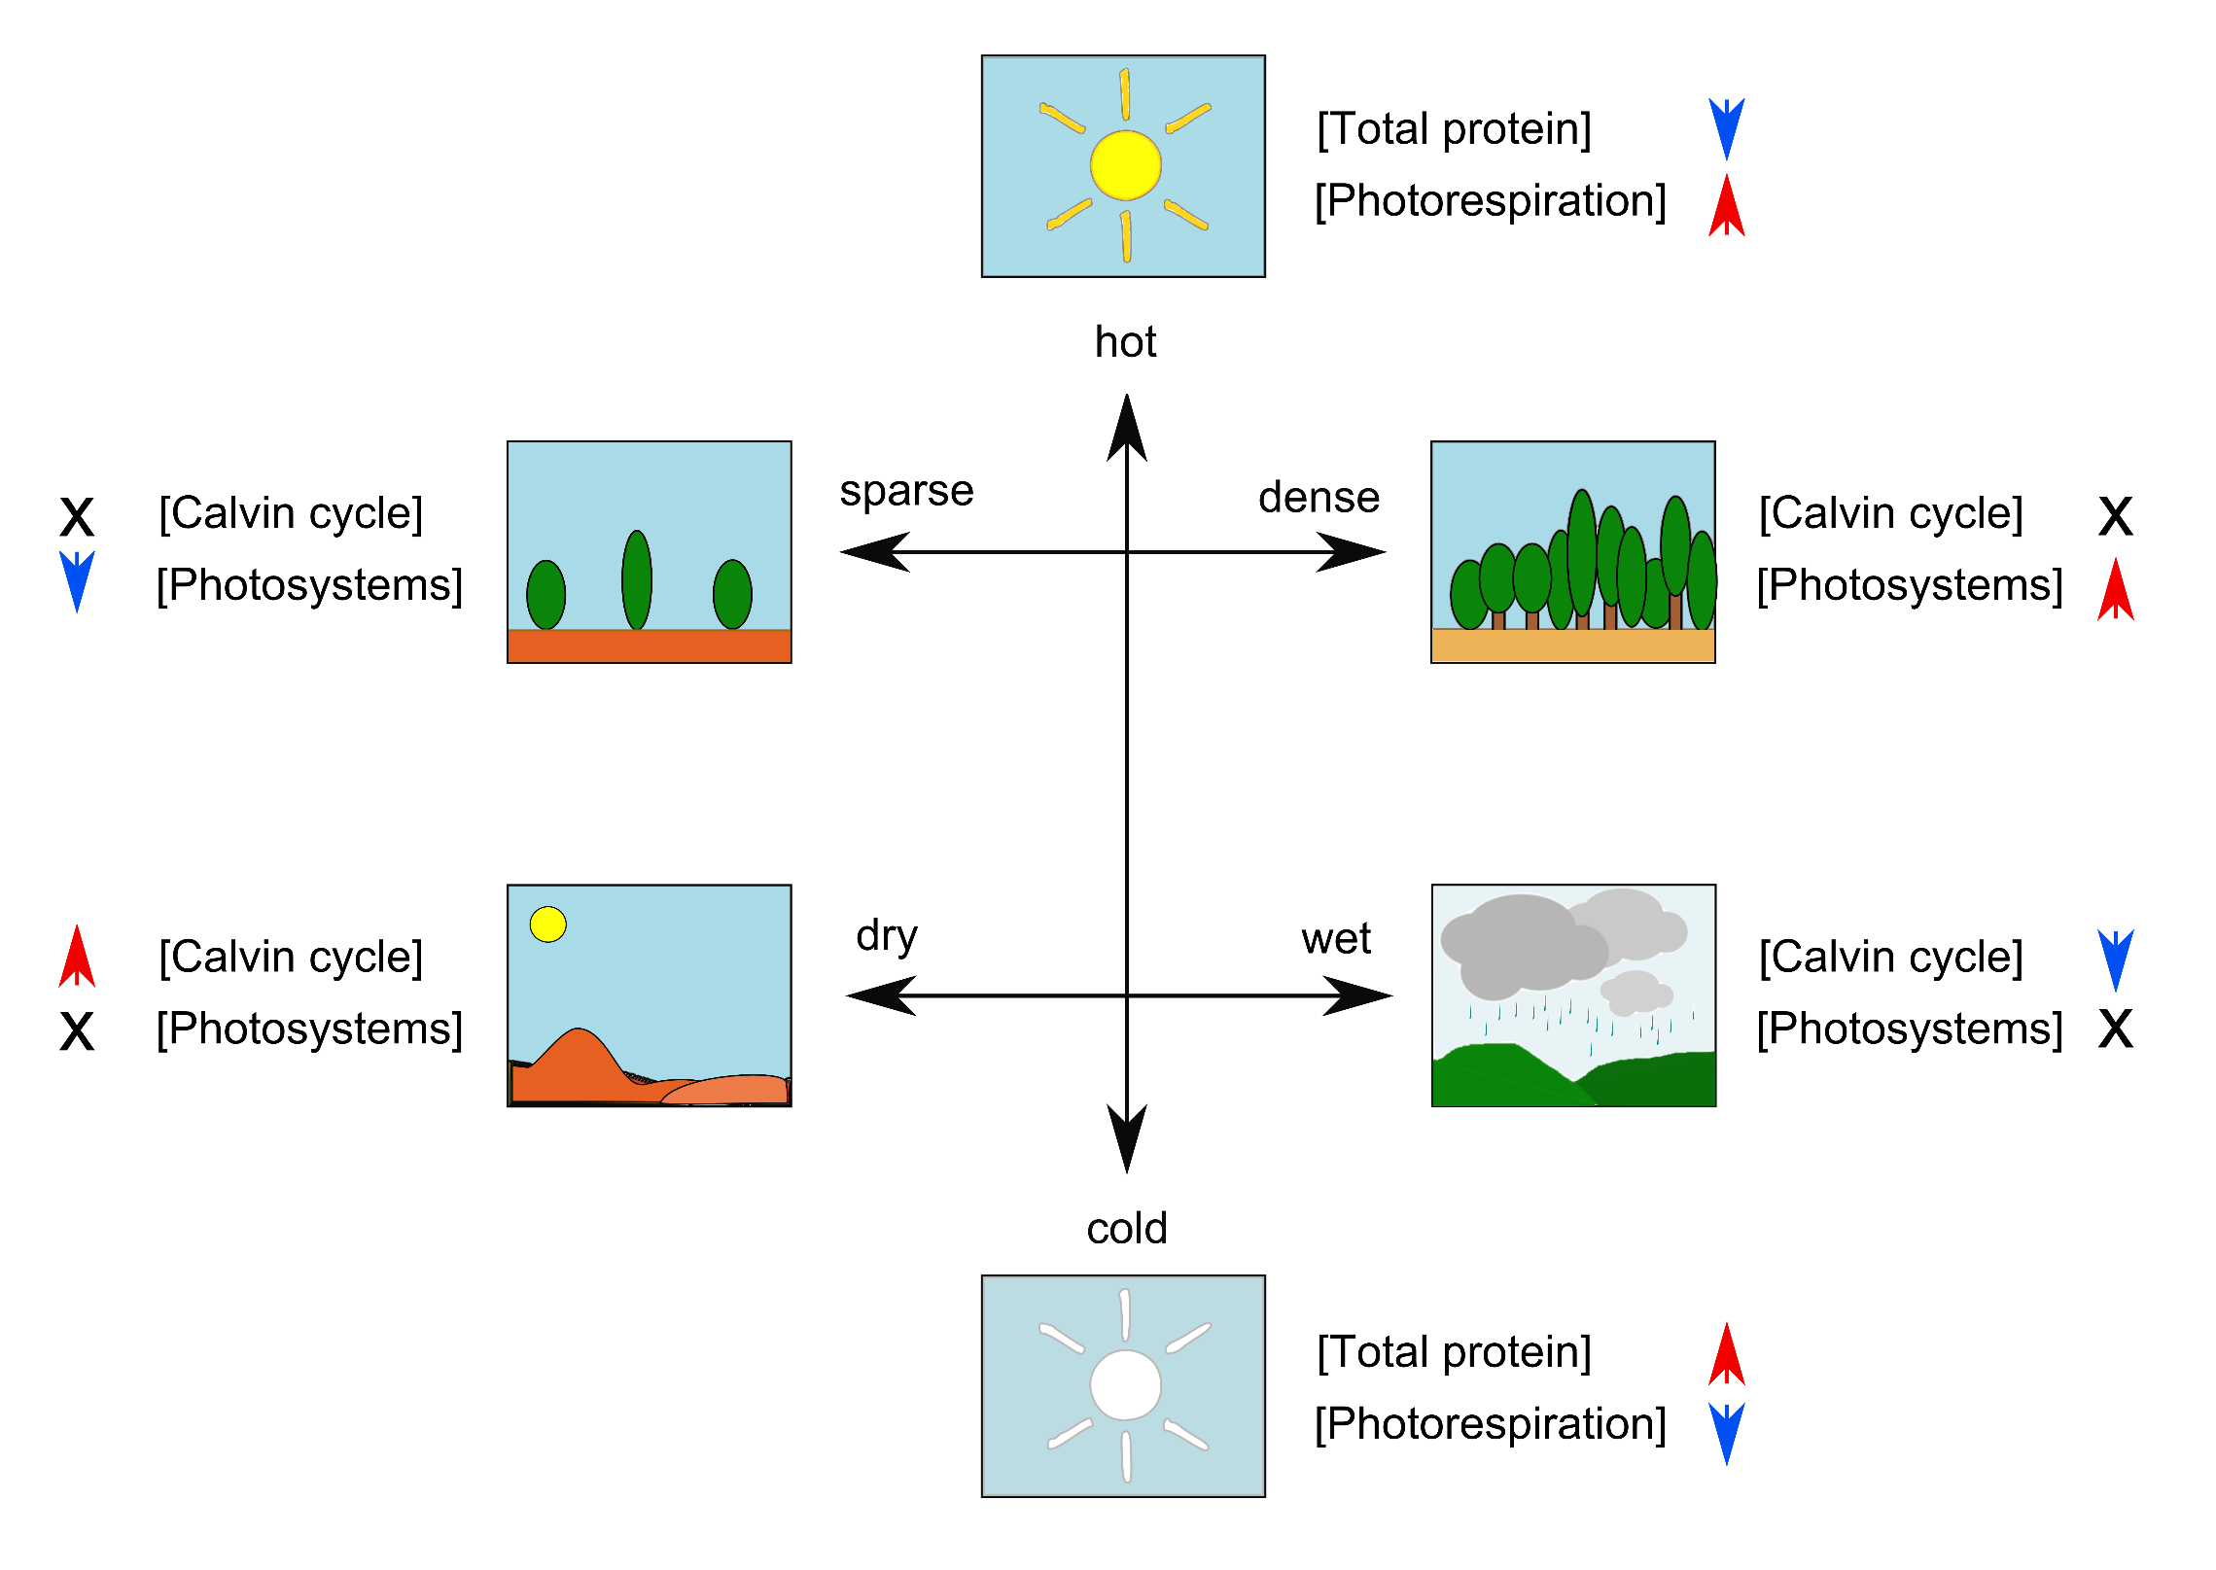

Slide 7
Investment in photosystems is greater in low light
p < 0.001, R² = 0.43
p < 0.001, R² = 0.37
Notes:
Disentangling precip effect – if you look at precip over just the last year, there’s a much weaker correlation. Could mean that we’re really interested in time averaged effect on vegetation structure and light evnrio

Slide 8
Investment in photosystems is greater in low light
p < 0.001, R² = 0.43
p < 0.001, R² = 0.37
X-fold variation in photosystem protein abundance
Notes:
Disentangling precip effect – if you look at precip over just the last year, there’s a much weaker correlation. Could mean that we’re really interested in time averaged effect on vegetation structure and light evnrio

Slide 10
Marginal influence of environment on investment in Calvin cycle
p = 0.19
p =0.02, R² = 0.16
p = 0.07
Calvin cycle protein abundance varies between X and X, x fold change
Proportional allocation to Calvin cycle proteins not very responsive to environmental conditions

Slide 11
Marginal influence of environment on investment in Calvin cycle
p = 0.19
p =0.02, R² = 0.16
p = 0.07

Slide 12
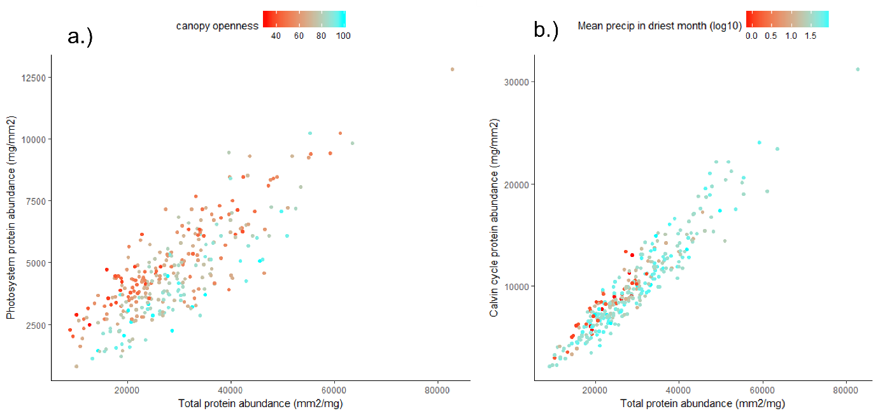

Slide 13
Expected trends

Slide 14
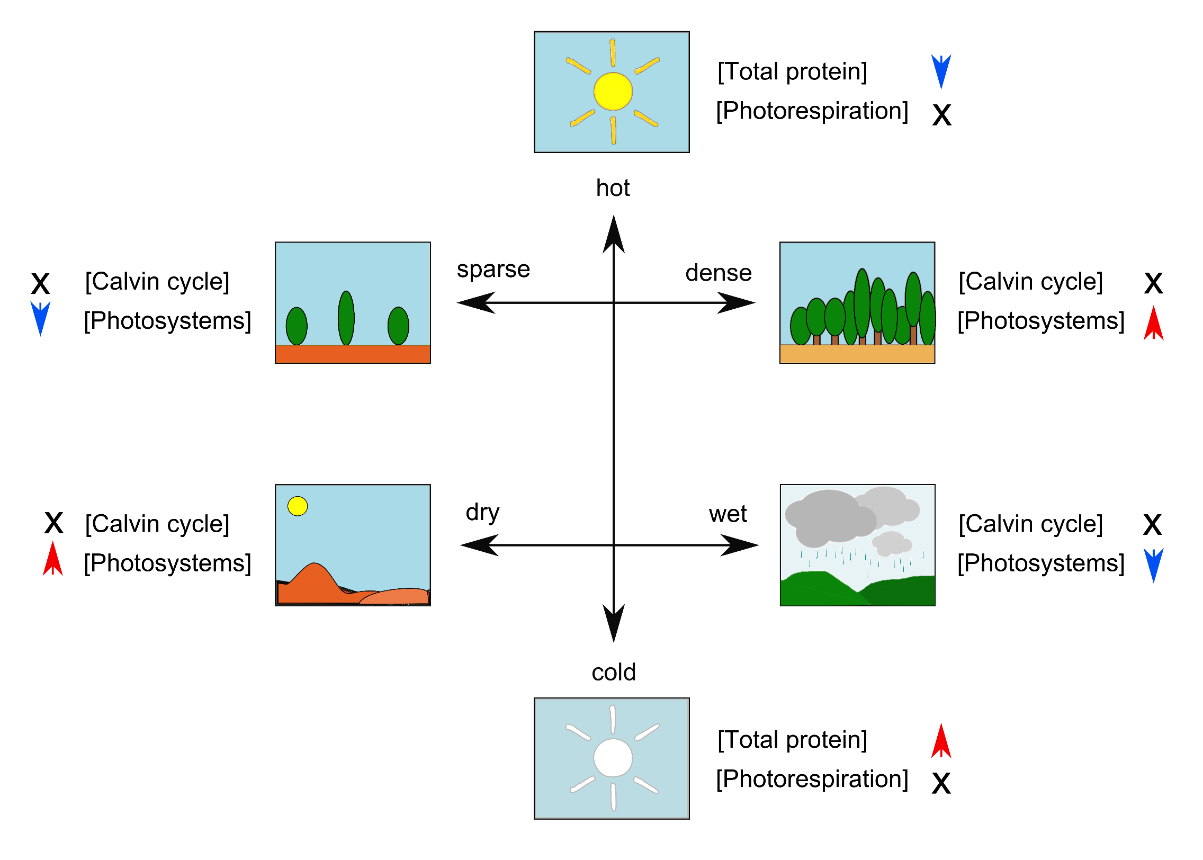
Actual trends

Slide 15
Protein abundance follows the leaf economic spectrum
Slopes?
p < 0.001, R² = 0.86
p < 0.001, R² = 0.31

Slide 16
LMA trends
p = 0.88
p < 0.001, R² = 0.26
p = 0.01, R² = 0.20
p = 0.15

Slide 17
Summary
Proportional investment in photosystems optimised according to photons / area
Proportional abundance of Calvin cycle enzymes not especially variable – total abundance / leaf area matters more and is optimised anatomically by changing leaf thickness

Slide 18
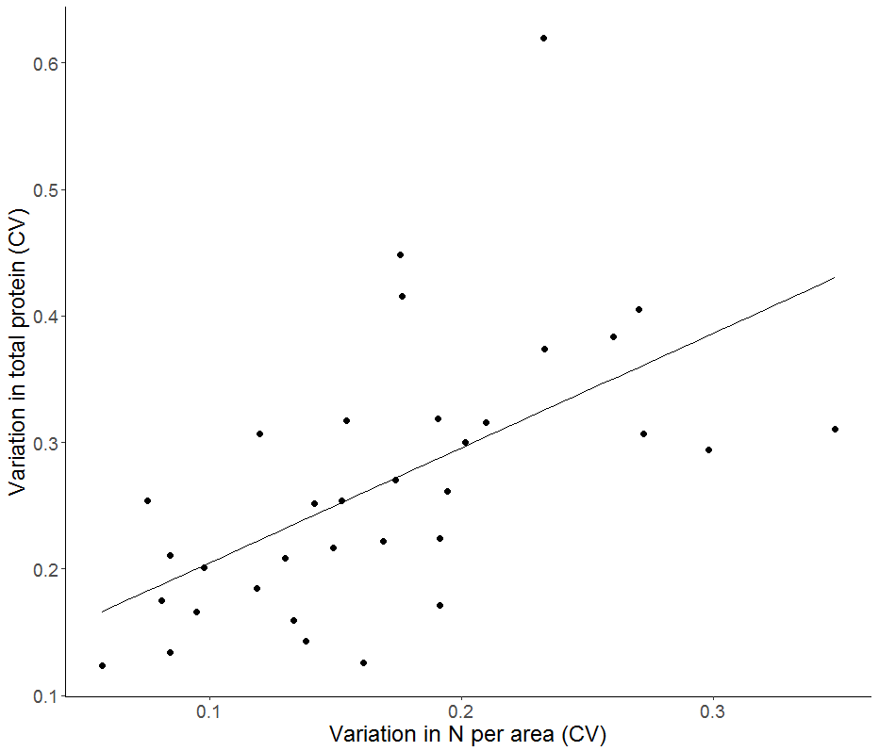

Slide 19
Environmental trends in leaf protein abundance
p = 0.66, R² = 0
p = 0.15, R² = 0.06
p = 0.03, R² = 0.13
p < 0.001, R² = 0.49

Slide 20
 | Canopy openness | Irradiance | Mean annual temp. | Mean annual precip.
Canopy openness | 1 | 0.85 | 0.2 | 0.55
Irradiance | 0.85 | 1 | 0.61 | -0.5
Mean annual temp. | 0.2 | 0.61 | 1 | 0.16
Mean annual precip. | -0.55 | -0.5 | 0.16 | 1
p < 0.001 R² = 0.32

